Slide 1
Relational Calculus
Chapter 4

Slide 2
Relational Calculus
Comes in two flavors: Tuple relational calculus (TRC) and Domain relational calculus (DRC).
Calculus has variables, constants, comparison ops, logical connectives and quantifiers.
TRC: Variables range over (i.e., get bound to) tuples.
DRC: Variables range over domain elements (= field values)
Both TRC and DRC are simple subsets of first-order logic.
Expressions in the calculus are called formulas.
An answer tuple is essentially an assignment of
constants to variables that make the formula
evaluate to true.

Slide 3


Tuple Relational Calculus
Nonprocedural query language
A query in the tuple relational calculus is expressed as
{t |P(t)} set of all tuples t such that predicate P is true for t.
Example: Find all sailors with a rating above 7
means there exists a tuple t in relation r such that predicate Q(t) is true
Example: Find all sailors sid with a rating above 7

Slide 4

Means Q is true for all tuples t in relation r
Example

Slide 5
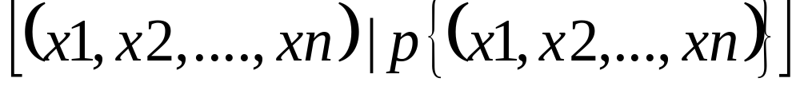
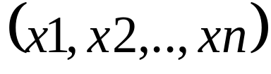

Domain Relational Calculus
Query has the form:
Answer includes all tuples that
makes the formula be true.
Formula is recursively defined, starting with simple atomic formulas (getting tuples from relations or making comparisons of values), and building bigger and better formulas using the logical connectives.

Slide 6
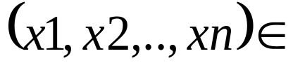






DRC Formulas
Atomic formula:
Rname, or X op Y, or X op constant
op is one of <,>,
Formula:
an atomic formula, or
, where p and q are formulas, or
, where variable X is free in p(X), or
, where variable X is free in p(X)
The use of quantifiers and is said to bind X.
A variable that is not bound is free

Slide 7
Free and Bound Variables
The use of quantifiers and in a formula is
said to bind X.
Let us revisit the definition of a query:
There is an important restriction: the variables
x1, ..., xn that appear to the left of `|’ must be
the only free variables in the formula p(...).

Slide 8

Find all sailors with a rating above 7
The condition ensures that the domain variables I, N, T and A are bound to fields of the same Sailors tuple.
The term (I,N,T,A) to the left of `|’ (which should be read as such that) says that every tuple (I,N,T,A) that satisfies T>7 is in the answer.
Modify this query to answer:
Find sailors who are older than 18 or have a rating under
9, and are called ‘Joe’.

Slide 9
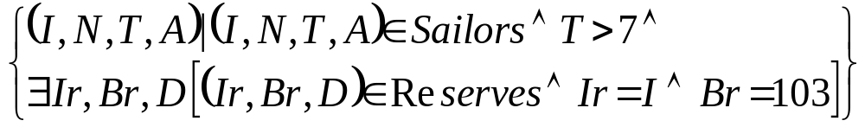


Find sailors rated > 7 who’ve reserved boat #103
We have used Ir, Br, D (…) as a shorthand for
Note the use of to find a tuple in Reserves that `joins with’ the Sailors tuple under consideration.

Slide 10
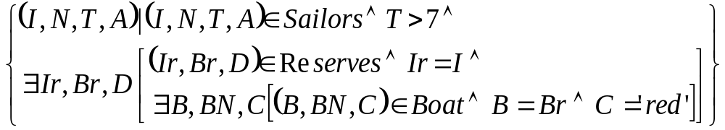
Find sailors rated > 7 who’ve reserved a red boat
Observe how the parentheses control the scope of each quantifier’s binding.
This may look cumbersome, but with a good user interface, it is very intuitive. (MS Access, QBE)

Slide 11
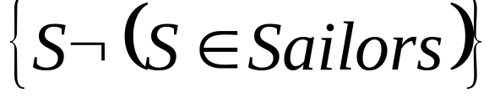
Unsafe Queries, Expressive Power
It is possible to write syntactically correct calculus queries that have an infinite number of answers! Such queries are called unsafe.
e.g.
It is known that every query that can be expressed in relational algebra can be expressed as a safe query in DRC / TRC; the converse is also true.
Relational Completeness: Query language (e.g., SQL) can express every query that is expressible in relational algebra/calculus.

Slide 12
Summary
Relational calculus is non-operational, and users define queries in terms of what they want, not in terms of how to compute it. (Declarativeness.)
Algebra and safe calculus have same expressive power, leading to the notion of relational completeness.

